Slide 1
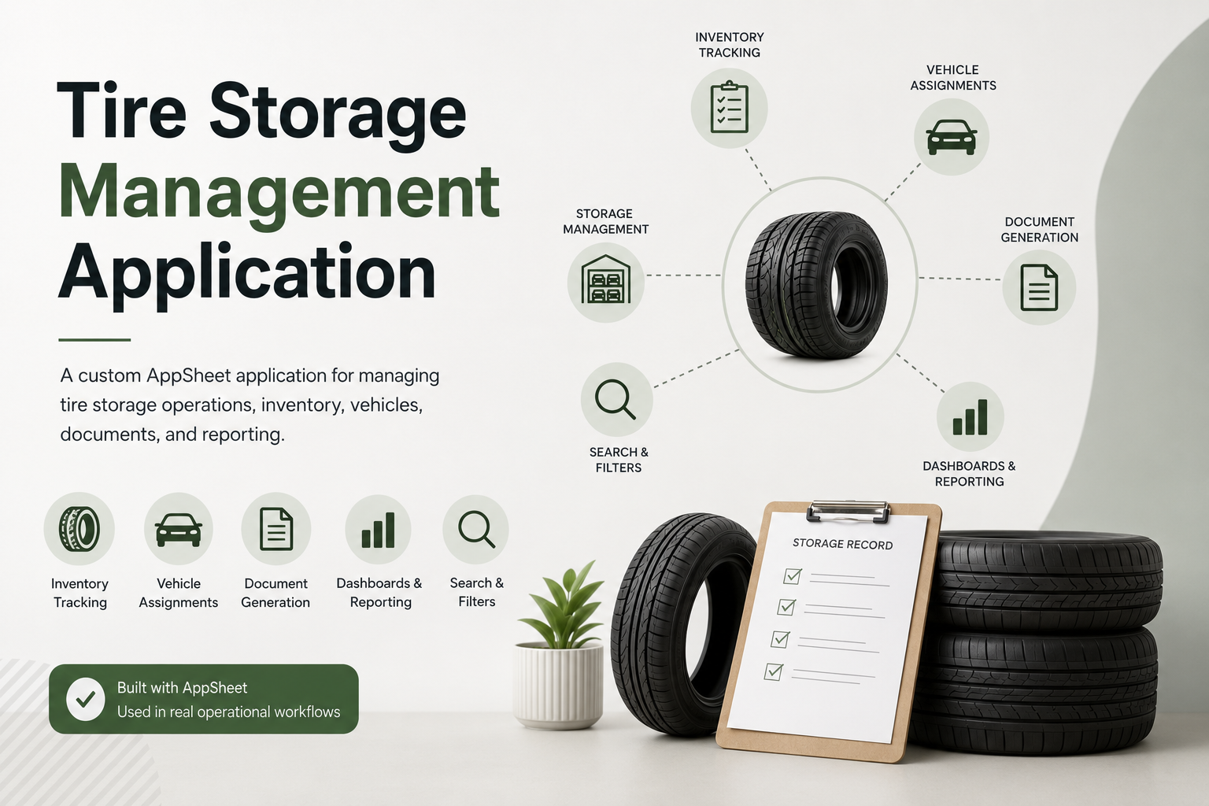

Slide 2
Project Overview
This project was created to provide a simple and organized way to manage stored tires, monitor their status, and keep all relevant information in one place.
Key Features:
Tire inventory tracking
Vehicle assignment
Search and filtering capabilities
Storage status monitoring
Dashboard and statistics views
PDF document generation
Centralized data management

Slide 3
Application Screenshots: Examples of the application's interface, including dashboards, views, forms, and reporting screens.

Slide 4
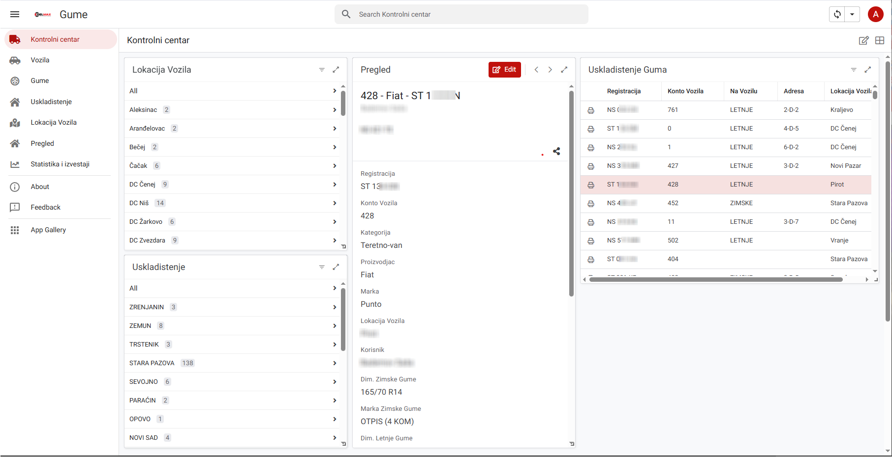

Slide 5
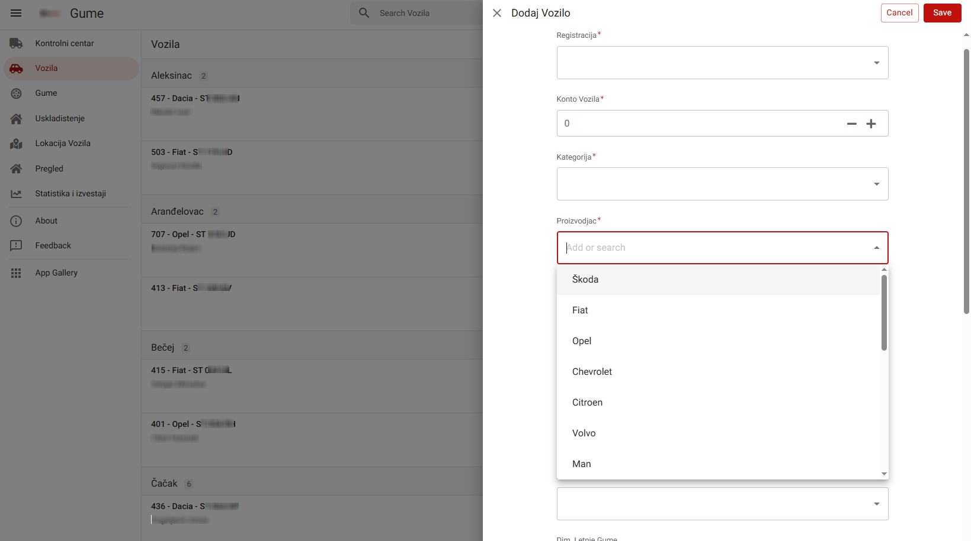

Slide 6
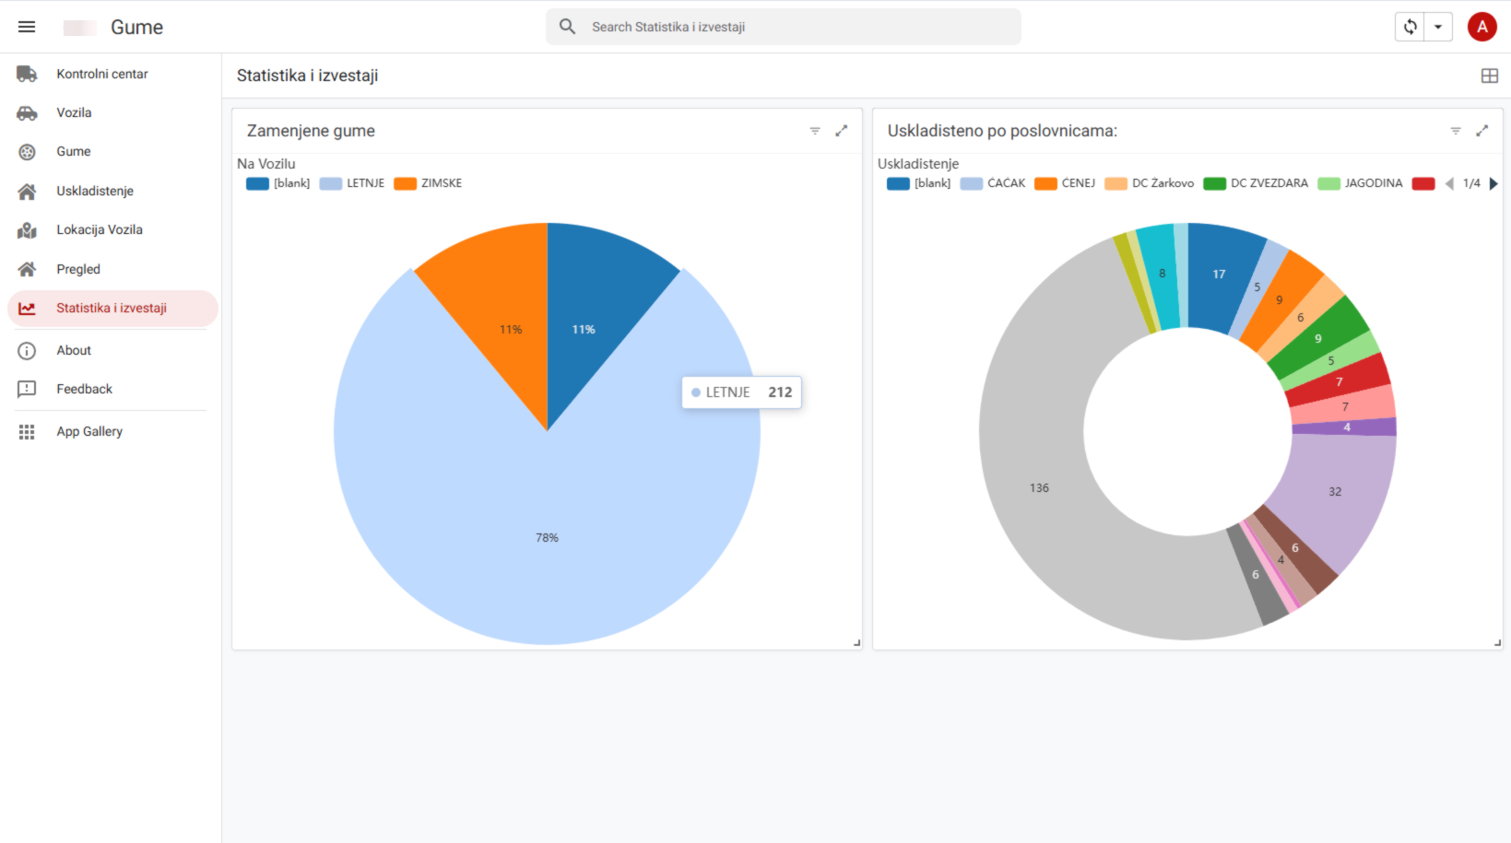

Slide 7
Thank you
Sladjana Solarevic
sladjanasolarevic@hotmail.com

